Slide 1

Stewardship: engaging your parish
Stewardship Day, October 18, 2014
Deacon John McDermott

Slide 2
Background
Deacon John McDermott
Ordained deacon in 2004
Assigned to Holy Apostles Church in 2012, a smaller inner city parish with 300 families. Established a Stewardship Team at the same time.
Previously assigned to St Rita Church, a large suburban parish with 2500 families for 8 years. Worked with Stewardship Team there
Business background
Currently Executive Director of Providence Housing for DOR
Previously worked in the private sector in a variety of management positions
Involved in lots of change management efforts over the years
Married with four children and five grandchildren

Slide 3
Agenda
Agenda for this webinar
What is stewardship?
Metrics and programs
What kind of results can you expect?
Key challenges along the way

Slide 4
What is Stewardship?

Slide 5
What Is Stewardship?
Does Your Parish Look Like This?
A Parish in Long Island
Completed their annual CMA target in one weekend
Over 600 involved in parish ministries
When families are transferred out of state, they change jobs to be able to return to their home parish
A parish in Kansas with 2600 families
Has no fundraising efforts except the weekly collection
  Offers free tuition at the parish school to all parish members with 750 students
Has 300 adults in attendance at daily mass and 85% attend mass every weekend.
RCIA averages 35 catechumens and candidates
These are Stewardship Parishes

Slide 6
What Is Stewardship?
What is Stewardship?
“As Christian stewards, we receive God’s gifts
gratefully, cultivate them responsibly, share them
lovingly in justice with others, and return them with
increase to the Lord.”
—1992 US Bishops’ Pastoral Letter, Stewardship: A Disciple’s Response
More than a program to raise more money for the parish
Attempts to create the worldview of a Christian disciple
  God has created the world, but entrusts it to us for responsible care
  All that we have is a gift of God
  All our resources of time, talent and treasure come under the Lordship of Jesus Christ
At the parish level, it is about driving member engagement

Slide 7
What Is Stewardship?
What Leads to a Healthy Parish?
Spiritual Commitment
Parish Engagement
Spiritual Health

Slide 8
What Is Stewardship?
What Leads to a Healthy Parish?
Parish Engagement
Spiritual Commitment
Spiritual Health

Slide 9
What Is Stewardship?
What Is Engagement?
“Strong congregations produce spiritually mature individuals whose lives have a positive influence on our society and world.”—George Gallup
Levels of engagement
Engaged
Not engaged
Actively disengaged
Engaged parishioners –more likely to show spiritual commitment by :
Inviting friends, family and co-workers to parish events
Giving of their time and skills to parish life and ministries
Giving financially to the parish, even sacrificially
Not engaged—may attend regularly but not psychologically connected. Socially but not spiritually committed. Give moderately but not sacrificially.
Actively disengaged—psychologically absent. Unhappy and want to share that unhappiness with everyone they meet!

Slide 10
What is Stewardship?
What Drives Engagement?
1. As a member of this parish I know what is expected of me.
2. In my parish my spiritual needs are met.
3. In my parish I regularly have the opportunity to do what I do best.
4. In the last month I have received recognition or praise from someone in my parish.
5. The spiritual leaders in my parish seem to care about me as a person.
6. There is someone in my parish who encourages my spiritual development.
7. As a member of my parish, my opinions seem to count.
8. The mission or purpose of my parish makes me feel my participation is important.
9. The other members of my parish are committed to spiritual growth.
10. Aside from family members I have a best friend in my parish.
11. In the last six months, someone has talked to me about the progress of my spiritual growth.
12. In my parish, I have opportunities to learn and grow.

Slide 11
What Is Stewardship?
US Congregational Average Scores
Question Number

Slide 12
What Is Stewardship?
Typical US Catholic Congregation Profile

Slide 13
What Is Stewardship?
What Is the Goal of Stewardship?
Increase Parish Engagement!

Slide 14
Metrics & Programs

Slide 15
Metrics & Programs
Stewardship Metrics—An Example
Engagement: Periodic engagement survey
  Engaged
  Not engaged
  Actively disengaged
Time: weekly mass attendance as % of total registered households
Talent: % of members involved in some additional parish ministry or service activity
Treasure: annual giving of parishioners

Slide 16
Metrics & Programs
Stewardship Activities
Educate team and parish on meaning of stewardship
  Bulletin articles
  Homilies
  Sign boards
  Stewardship Day events, reflection days, conferences
Measure parish engagement and level of time, talent and treasure
Report to pastor and pastoral council on findings and opportunities
Organize activities to promote stewardship
  Annual Stewardship Day/Events
  Ministry Fairs
  Annual pledging/commitment weekend
  Support for CMA
Create a funnel of volunteers to ministries of the parish

Slide 17
Metrics & Programs
Relationship to Other Parts of the Parish
What it does
Informs and supports Pastoral Council on issues and opportunities
Assists Finance Council by finding ways to increase giving and other forms of income
Supports all ministries by promoting opportunities to volunteer and matching up those having a desire to serve with the needs
What it doesn’t do
Set policy, vision or plans for the parish (Pastoral Council)
Set budgets or monitor spending (Finance Council)
Create spiritual events or ministries (Liturgy, Faith Formation, Outreach)
Organize events to bring in new members (Evangelism, Communications)

Slide 18
What kind of results to Expect

Slide 19
What to Expect
What to Expect in Stewardship Parishes
Higher rates of attendance at weekend and daily masses
Higher rates of financial giving
  Lower number of fundraising events
Higher rates of volunteerism and participation in the life of the parish
These results take time and significant commitment to build

Slide 20
What to Expect
Holy Apostles: Stewardship Example
  Began Stewardship Team in summer 2012
  Conducted first Engagement Survey in November 2012
  Showed that we were building on a strong base of engagement

Slide 21
What to Expect
Holy Apostles—Key Engagement Metrics
30% of parishioners participating in parish activities:
  50 different activities to be involved in
  40 people involved with Christ Life
Average rate of attendance at weekend mass: >40%
Achieved CMA last two years
  Highest rate of participation in DOR: 54%
Parish budget moved from deficit to surplus

Slide 22
What to Expect
Holy Apostles—Impact on Giving
Impact on Giving—
40% growth in weekly collections over three years
  Avg $500 per HHD
  Giving per person up 55%
  Exceeded CMA by 10%
  Est 1.7% of PIP
Meanwhile, attendance has declined by 10%
Results due to:
  Increased preaching about tithing
  Lay witness talks about tithing
  Increased info about parish finances
  CMA weekend
  Annual commitment weekend

Slide 23
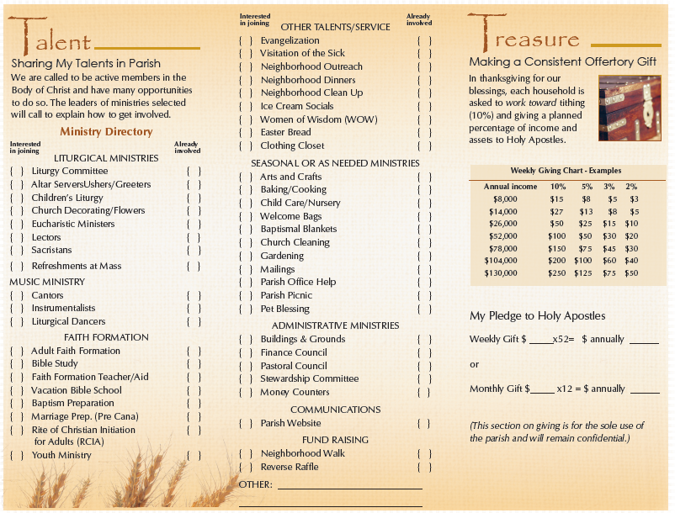
What to Expect
Sample Commitment Card

Slide 24
What to Expect
Results on Giving—St Rita Church

Slide 25
What to Expect
Does This Work in Other Places?
During this period we doubled % of engaged employees and also…
Sales increased 50%
Customer complaints dropped by 70%
Productivity improved by over 40%
Honored for Best Workplaces in America 10 times by printing industry

Slide 26

Challenges on the Way
Challenges Along the Way
Why should we measure?
Its just about the money!
Are we there yet?
Other issues?

Slide 27
Conclusion
Conclusion
Stewardship should be at the heart of every parish
Stewardship is about engagement
Measure your progress!
You can see relatively quick results in finances
  Better to take a balanced approach
This is a long term effort—not a quick fix
Do you want to transform your parish?
Build a Stewardship Parish!

Slide 28
Reference
For Further Reference
USCCB, Stewardship: A Disciple’s Response, 1992.
Wagner, Rodd & James K. Harter, 12: The Elements of Great Managing, Gallup Press, New York, 2006.
Winseman, Albert L., Donald O. Clifton and Curt Liesveld, Living Your Strengths (Catholic Edition), Gallup Press, New York, 2006.
Or contact me with questions:
Deacon John McDermott
jmcdermott104@gmail.com

Slide 29
Thank You!!

